Slide 1
ALADN 2013 Pre-Conference
Major Gifts Overview
Gregory Perrin, University of Texas at Austin
Adelle Hedleston, Texas A&M University

Slide 2
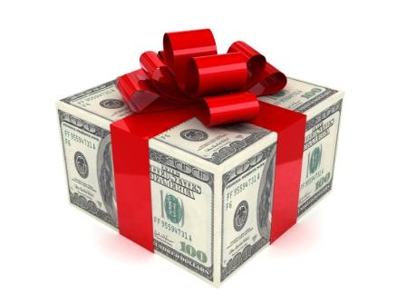
Annual Gifts versus Major Gifts
VS

Slide 3
Annual Gifts
Level of giving - $1 to $24,999
Frequent gift that helps sustain institution on an annual basis
Unrestricted
Solicited by direct mail, e-mail, phone calls or in person
Builds a base of steady support that may result in a major gift in the future.

Slide 4
Major Gifts
Given for designated project
Level of giving is $25,000 or more
Occur infrequently
Solicited in person usually with a proposal or gift agreement
Are about relationships
Longer cultivation period
Part of a planned/estate gift or a current gift

Slide 5
Major gifts involve…
Relationships and trust
Longer cultivation period
Donor engagement
Awareness of projects and programs
Asking – you won’t get them if you don’t ask

Slide 6
Types of Major Gifts
Endowments (Collections, programs or projects)
Bequests/Planned Gifts
Collections (Appraised In Kind gifts)
Scholarships
Chairs/Directorships/Professorships
Facilities

Slide 7
How to Identify a Major Gift Prospect

Slide 8
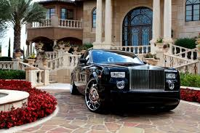
How to Identify a Major Prospect
Qualify
1. What’s the donors capacity for giving?
Income
Family wealth – will they be inheriting wealth?
Holdings and assets – Where do they live? How many houses or property do they own? Where is it located?

Slide 9
How to Identify a Major Prospect
2. Identify a donor’s proclivity or tendency to give
Are they involved in the community?
Do they give to other charities?
Do the charities they support have similar goals and visions as your institution?
And are they making major gifts to these charities?
Have they given to your institution before?
If so, what college, unit or department?
How big was their gift?

Slide 10
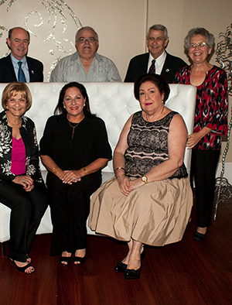
How to Identify a Major Prospect
3. Utilize your board members
Wealthy people know other wealthy and connected people. Have your board member invite their friends and colleagues to library events, etc.
Use your board members to get introduced to people you normally wouldn’t have the opportunity to meet on your own. Build relationships with people they know.

Slide 11
How to Identify a Major Prospect
4. Analyze current donors
Are they consistent givers?
Have they given 5 years or more?
5. Ask central development or foundation research unit for help in generating a list.

Slide 12
Who are your potential major donors?
Your current donors
Consistent donors – 5 years of more
Retired faculty and staff
Alumni who worked in the library
Alumni who received graduate degrees
Your board members (Friends board, Advisory Council, Development Council)
Friends of the Library groups

Slide 13
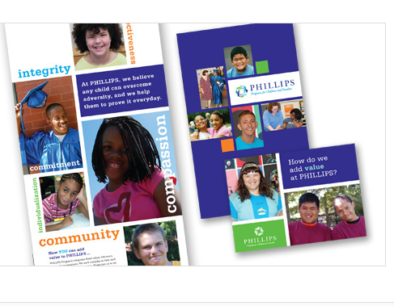
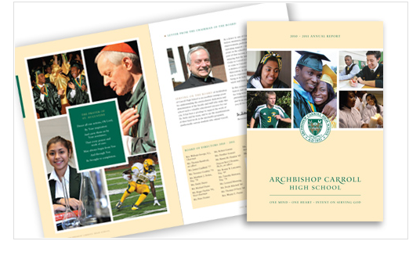
Cultivation
Every letter, brochure, phone call, conversation and event forms an impression on a donor.
Make your message impressive and consistent.

Slide 14
What is Cultivation?
Relationship-building that leads to giving
You learn about donors and they learn about your institution
May take 2 – 5 years…or more
Define the most important things you want your donors to know about your mission
Find out your donor’s passion. People are more invested if they are give to something that they are passionate about.

Slide 15
Cultivation
Focus on key issues to create awareness among your donors
Use your boards to be ambassadors for your library, but make sure their message is your message.

Slide 16
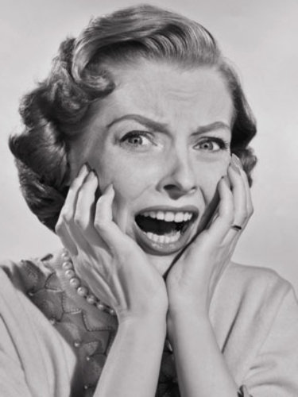
Process for Making the Ask

Slide 17
Process for Making the Ask
You can NEVER prepare too much.
Is the donor at the appropriate stage of cultivation to be asked?
Are they interested in giving to your library?
What is their capacity?
What would they like to accomplish with their money that is meaningful to them?
Who will make the ask?
Who needs to be present?

Slide 18
Process for Making the Ask
Prep your dean, director or department head
Avoid asking over a meal
Be prepared to respond to Yes, No or Maybe.
Factor in multi-year giving, blended gifts, and planned gifts

Slide 19
Process for Making the Ask
Have follow up plan outlined before asking
Asking is a conversation…not a transaction
After you have asked them…..LISTEN!
Thank them no matter what the response
Follow up

Slide 20
Stewardship…more than a thank you
Doesn’t end after gift is received
Stay in touch – communicate often
Use the gift how the donor designates
Continue saying “thank you”
Expand the relationship
Acknowledge and recognize gift and donor
Report on the impact of the gift
Opportunity to cultivate for future gift

Slide 21
How to Turn Annual Giving into Major Gifts
Stewardship
Continued cultivation
Realizing a gift is the beginning of a relationship not the end.
Leverage special collections
Ask

Slide 22
Things to remember
Cultivate – donors make their giving decision on how well they know and trust your organization.
Solicitation - know what you are asking for, then make sure the donor knows.
Stewardship – can lead to future gifts.

Slide 23
Questions?

